Slide 1
Summer 2017 Episerver Developer & Editor Meetup Personalization & Promotions 1 // Evangelize OOB Commerce Promotions and Visitor Group Criteria 2 // Highlight a mechanism for bringing them together
Drew Null | June 8, 2017

Slide 2
Contents
1 // Personalization Intro
2 // Commerce Visitor Groups
3 // Promotions Intro
4 // Built-in Promotions
5 // Promotions + Personalization
6 // Demo

Slide 3
Personalization Tier 2: Visitor Groups

Slide 4
3 tiers of personalization
Tier 1
Automatic
Based on when a user is logged in
Known information stored within the site
Show unique content based on that person’s information and history
“Hello, Drew”
“Your recent orders…”
“Your cart…”
Tier 2
Segmented
Based on groups of visitors
Criteria based on implicit and explicit content
Show content targeted to a group of visitors browsing the site
“Visitors from Chicago”
“First time visitors”
“Visitors clicking from email marketing campaign”
Tier 3
Behavioral
Based on behavior of current visitor or similar visitors
Page visits and clicks are tracked and stored for later analysis
Unique content is returned using machine learning algorithms
“People who bought this also bought this…”
“You may also enjoy…”

Slide 5
3 tiers of personalization
Tier 1
Automatic
Based on when a user is logged in
Known information stored within the site
Show unique content based on that person’s information and history
“Hello, Drew”
“Your recent orders…”
“Your cart…”
Tier 2
Segmented
Based on groups of visitors
Criteria based on implicit and explicit content
Show content targeted to a group of visitors browsing the site
“Visitors from Chicago”
“First time visitors”
“Visitors clicking from email marketing campaign”
Tier 3
Behavioral
Based on behavior of current visitor or similar visitors
Page visits and clicks are tracked and stored for later analysis
Unique content is returned using machine learning algorithms
“People who bought this also bought this…”
“You may also enjoy…”

Slide 6
3 tiers of personalization
Tier 1
Automatic
Part of the overall implementation of the solution
Managed by developers
Tier 2
Segmented
Features needs to be supported by the content management system
Managed by editors
Tier 3
Behavioral
Third-party integration needed for implementation
Managed by AI

Slide 7
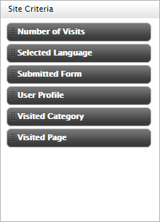
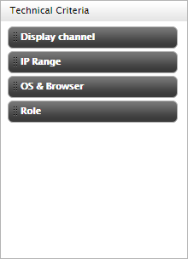
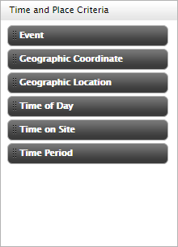
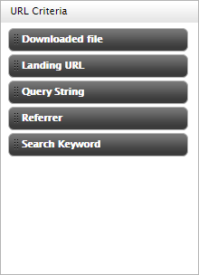

Visitor Groups Site visitors with something in common, such as age, geographic location, and so on. (it’s all about the criteria)

Slide 8
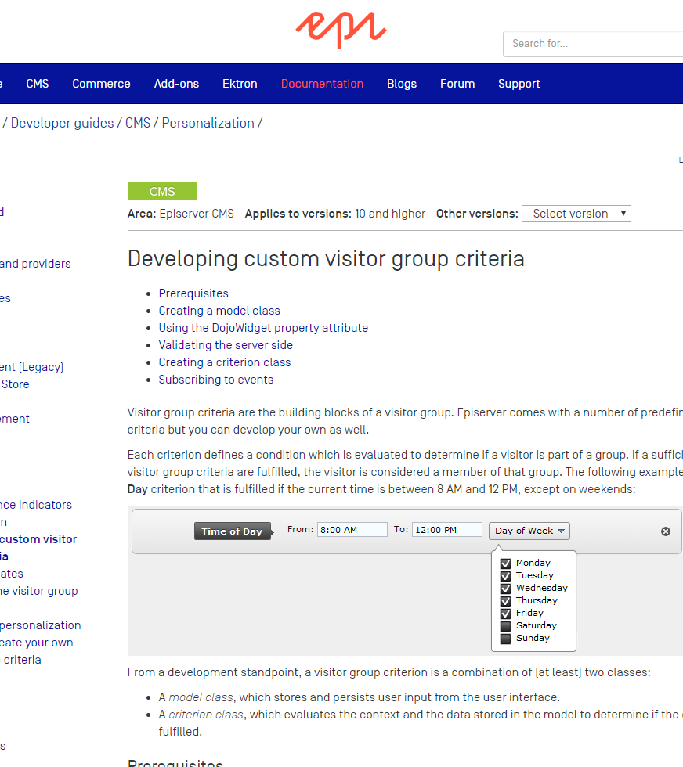
Custom Visitor Group Criteria

Slide 9
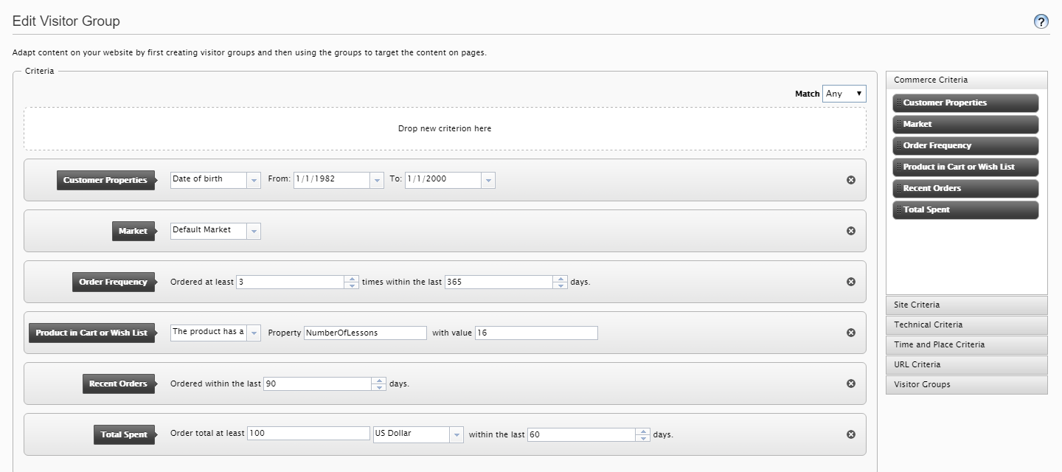
Commerce Visitor Group Criteria

Slide 10
Promotions

Slide 11
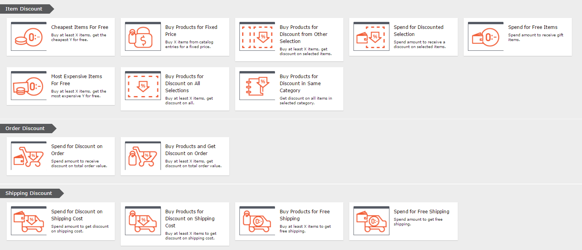
Built-In Promotions

Slide 12
OOB Promotions Breakdown
Conditions | Rewards | Discounts
Buy at least [x] items from [this selection] and [do/do not] include subcategories Spend at least [amount] of [currency] | Get [these entries], [do/do not] include subcategories, and [do/do not] limit the number of discounted items Get free items Get [selected shipping methods] | At the following discount: [percentage/amount] off Receive [catalog entries] at a fixed price: [price] of [currency] Get cheapest [x] item(s) for free Get the most expensive [x] item(s) for free

Slide 13
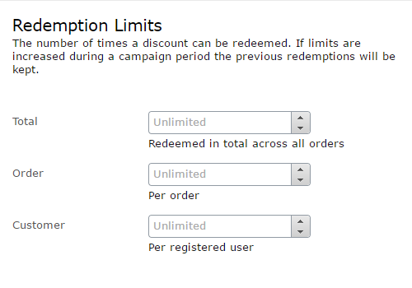
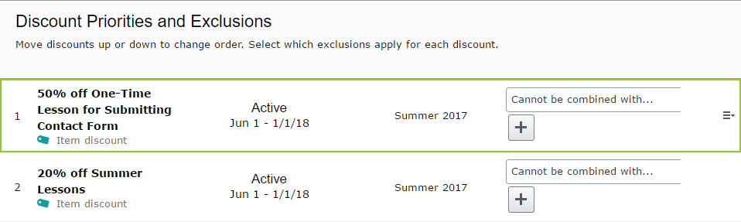
OOB: Redemptions and Exclusions

Slide 14
Demo: Visitor Groups + Promotions
// OOB: Per-Visitor Group Campaigns
// Custom: Visitor Groups as Promotion Conditions

